Slide 1
Forms World
Hindu Institute of Management - DCRUST
Represented by: Shubham - 20012041042

Slide 2
Contents
Introduction about the Project
Project Scheduling – Gantt Chart
Flow Chart
Screen Designs
Conclusion
Future scope
2

Slide 3
Introduction About the Project
We have build Forms World a service providing platform where users can create account and apply to various different form filling services available on the application.
Forms World aims to provide form filling services for various jobs, making it easy for users to fill out and submit forms online.
It allows people to easily purchase services.
3

Slide 4
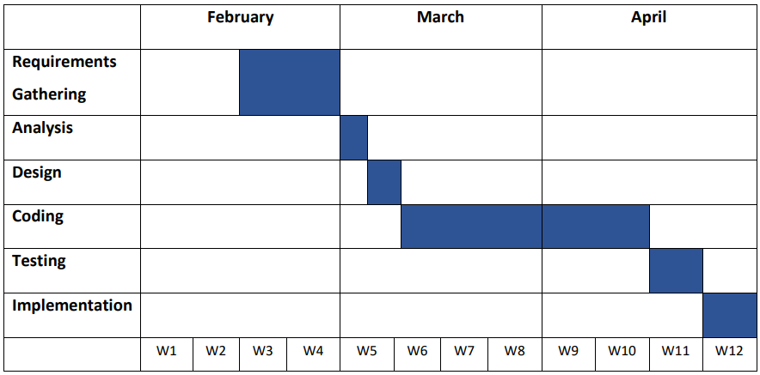
Project Monitoring (Gantt Chart)
A Gantt Chart is commonly used graphical depiction of a project schedule.
Gantt Chart
4

Slide 5
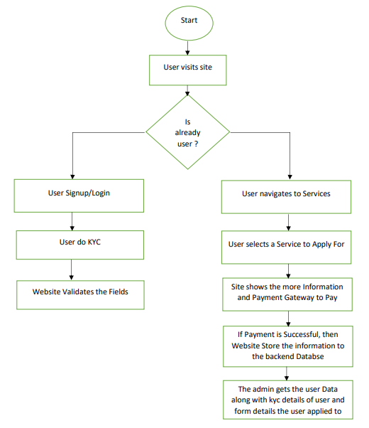
Flow Chart
A flowchart is a diagram that depicts a process, system or computer algorithm.
5

Slide 6
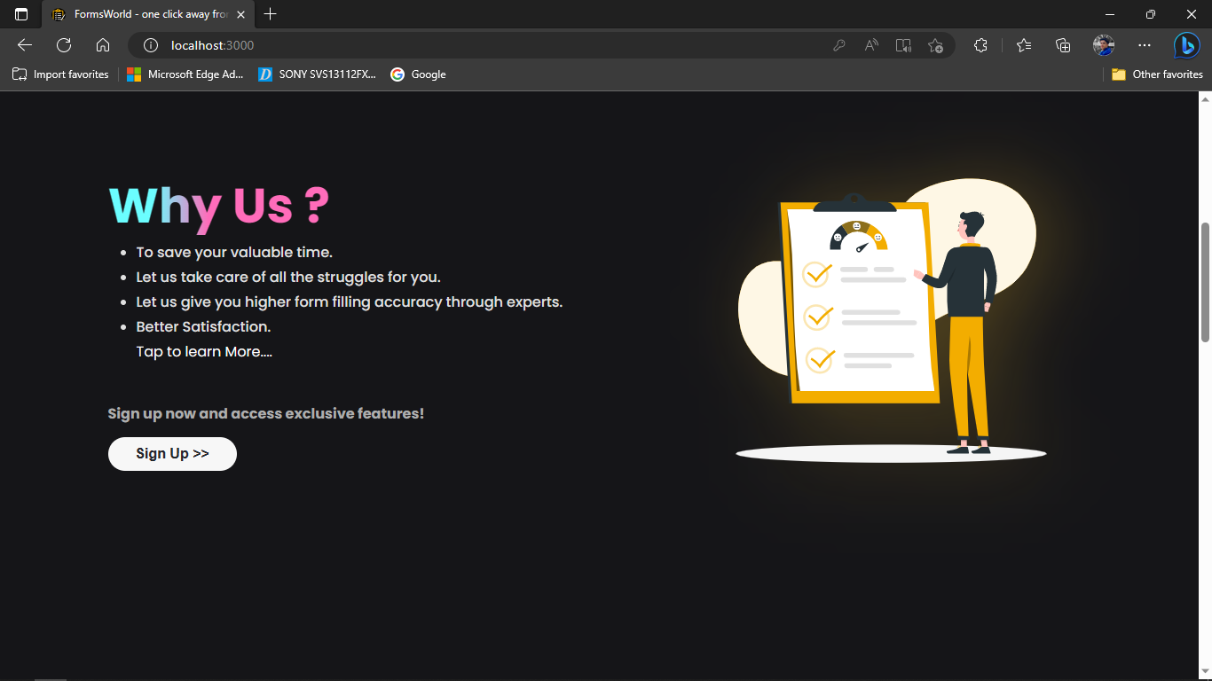
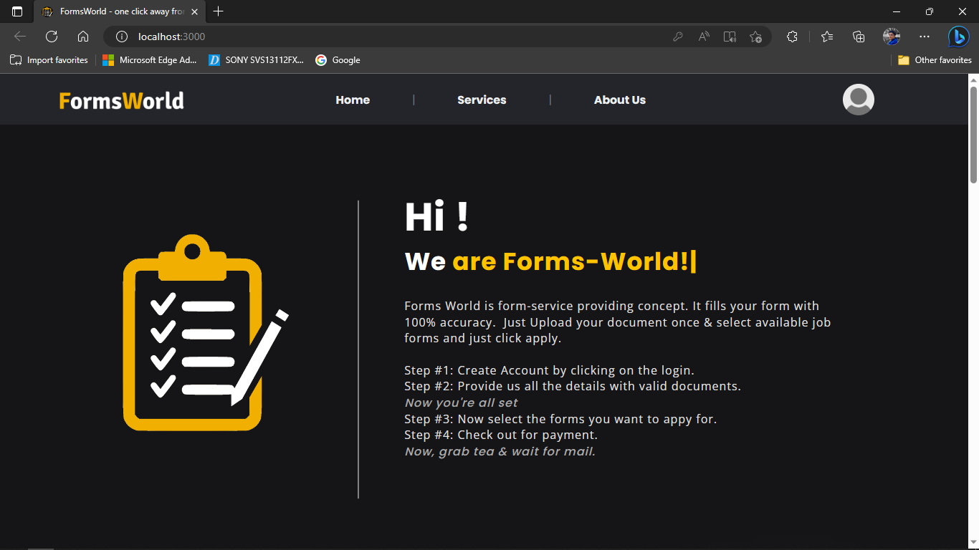
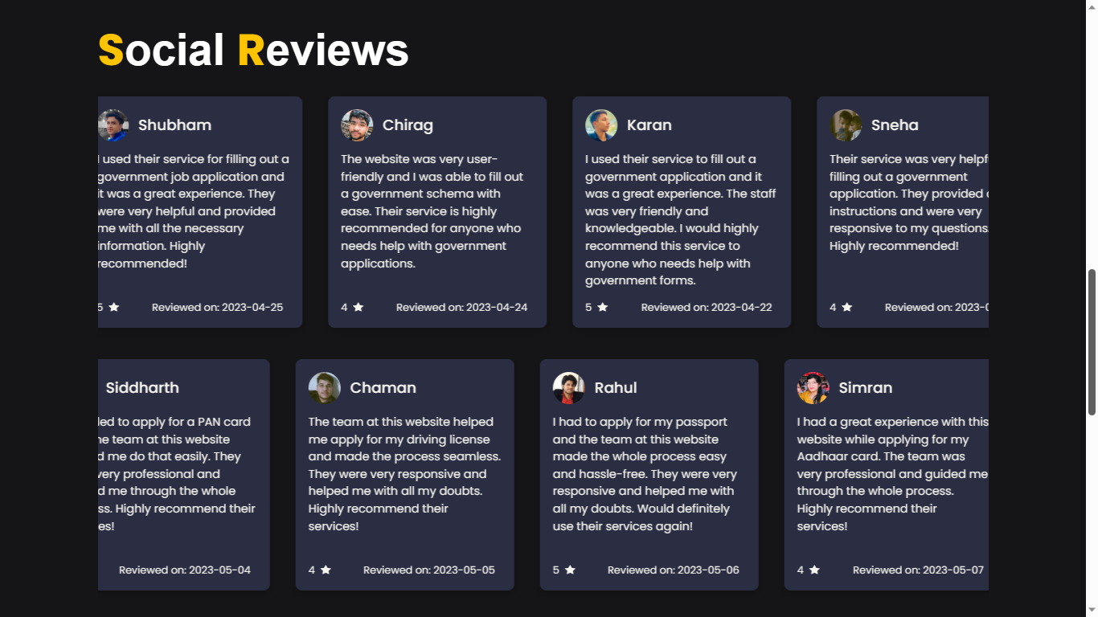
Screen Designs
1. Landing Page of Forms World
6

Slide 7
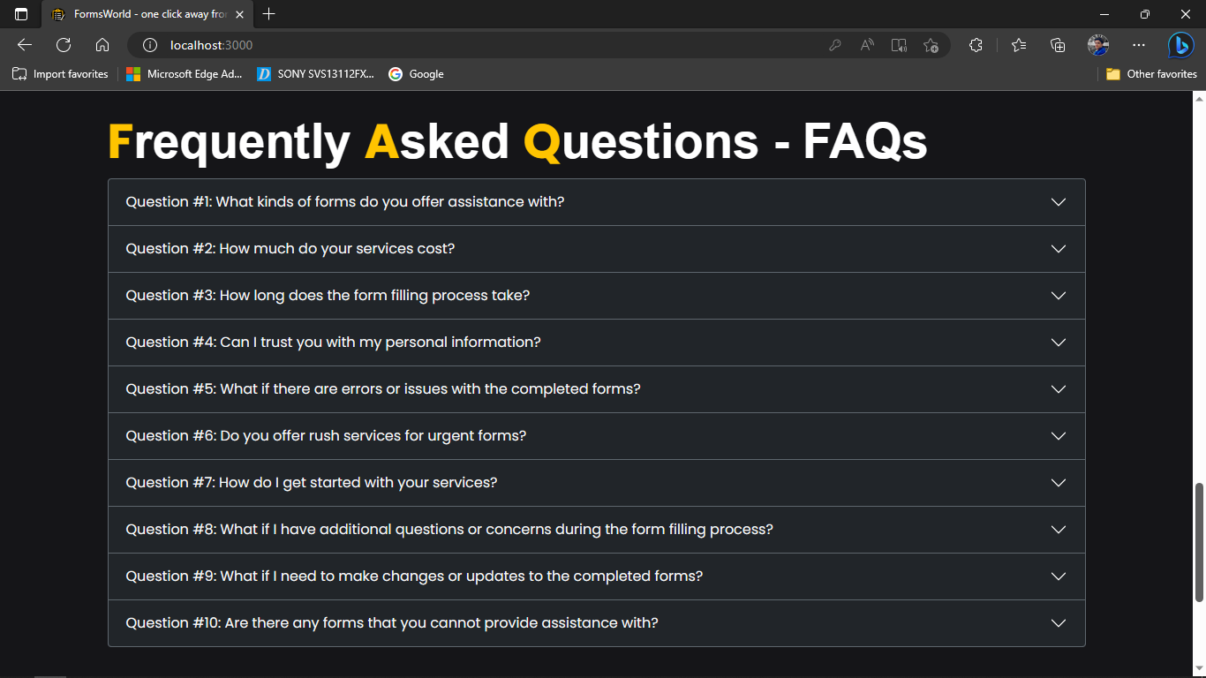
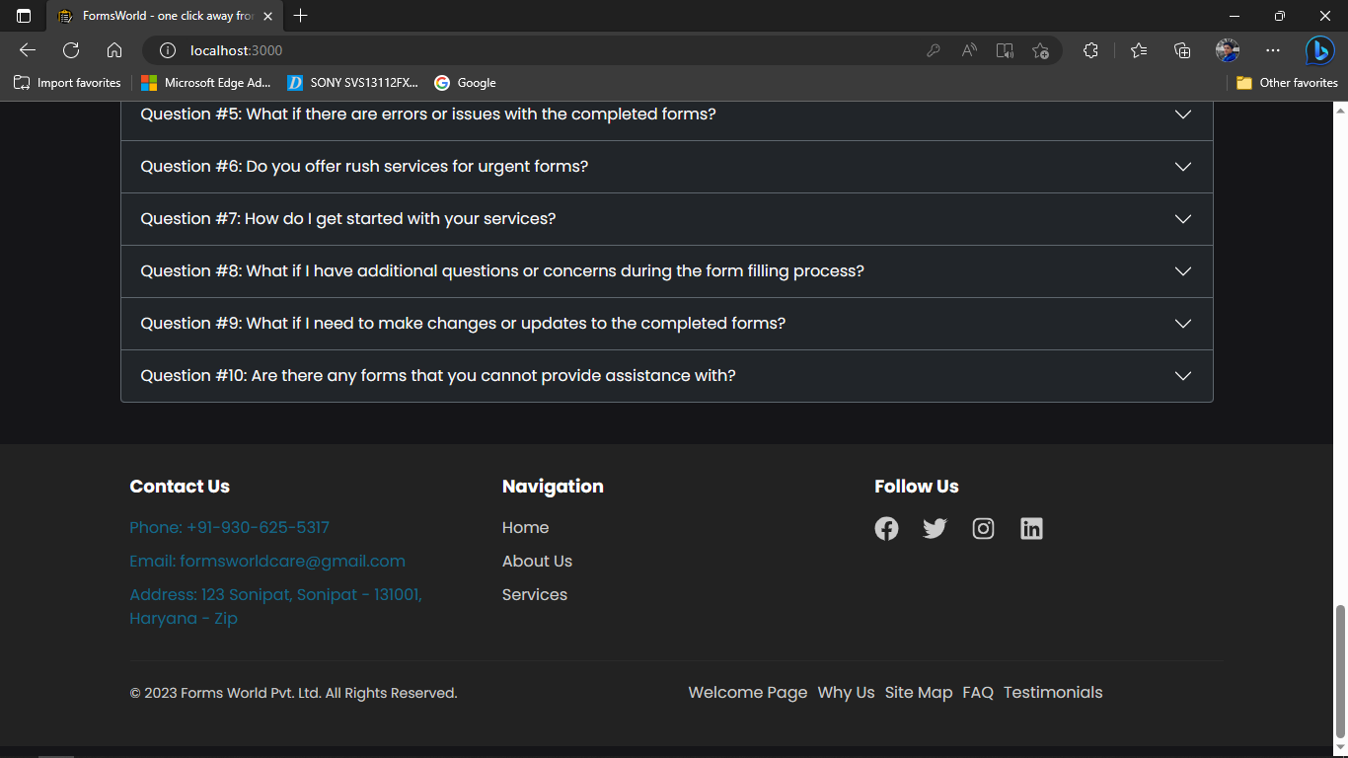
Screen Designs
Continued…
7

Slide 8
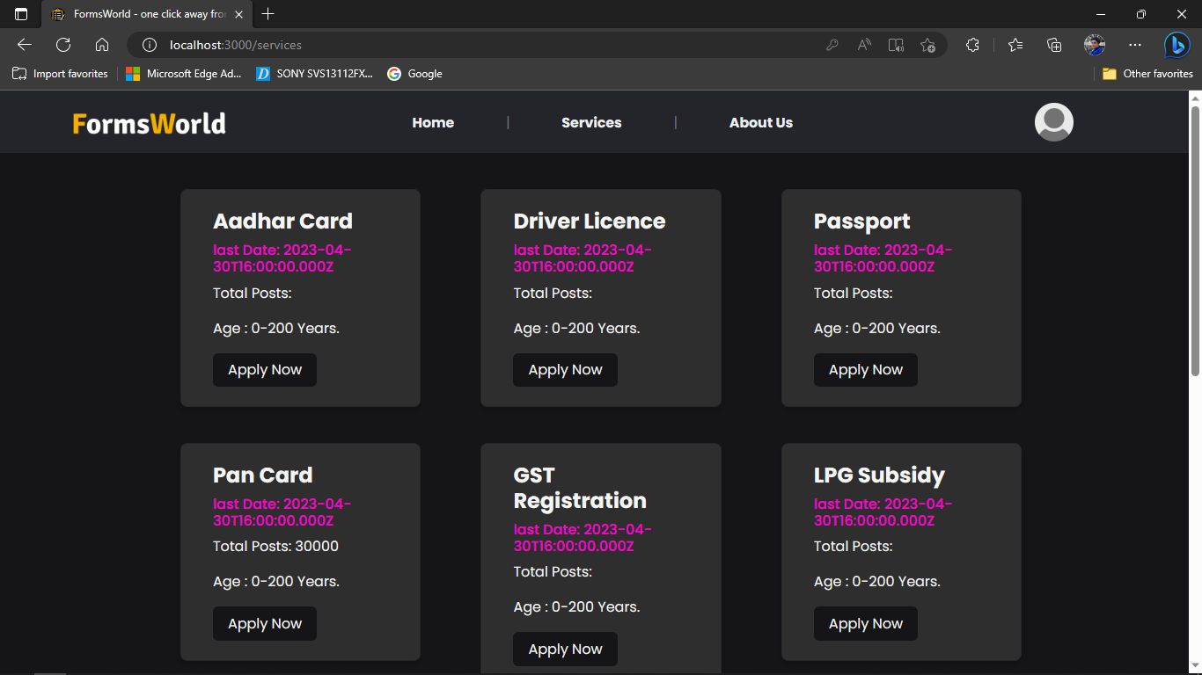
Screen Design
2. Services Page of Forms World
8

Slide 9
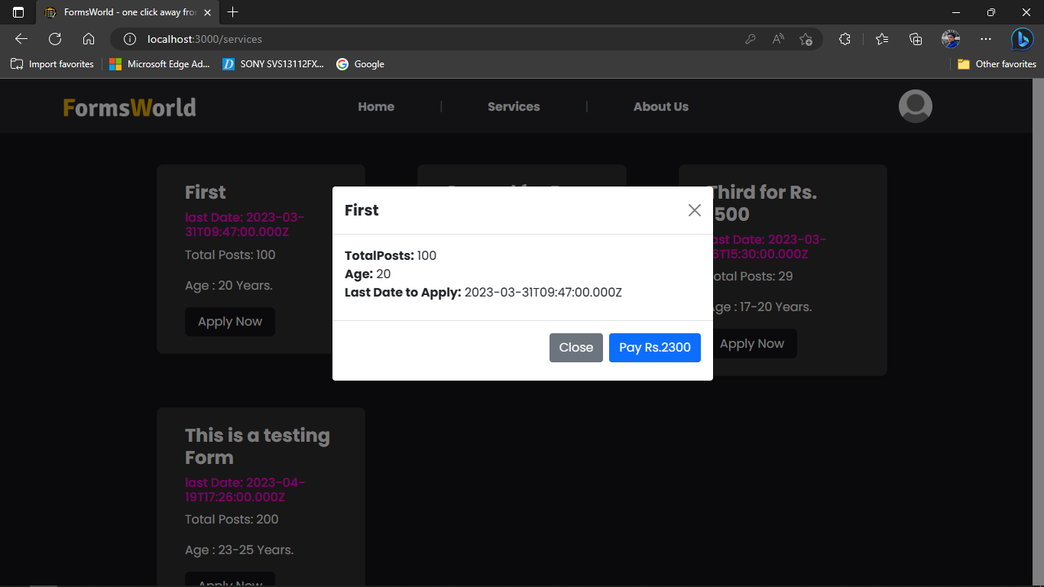
Screen Design
3. Form Details Modal
9

Slide 10
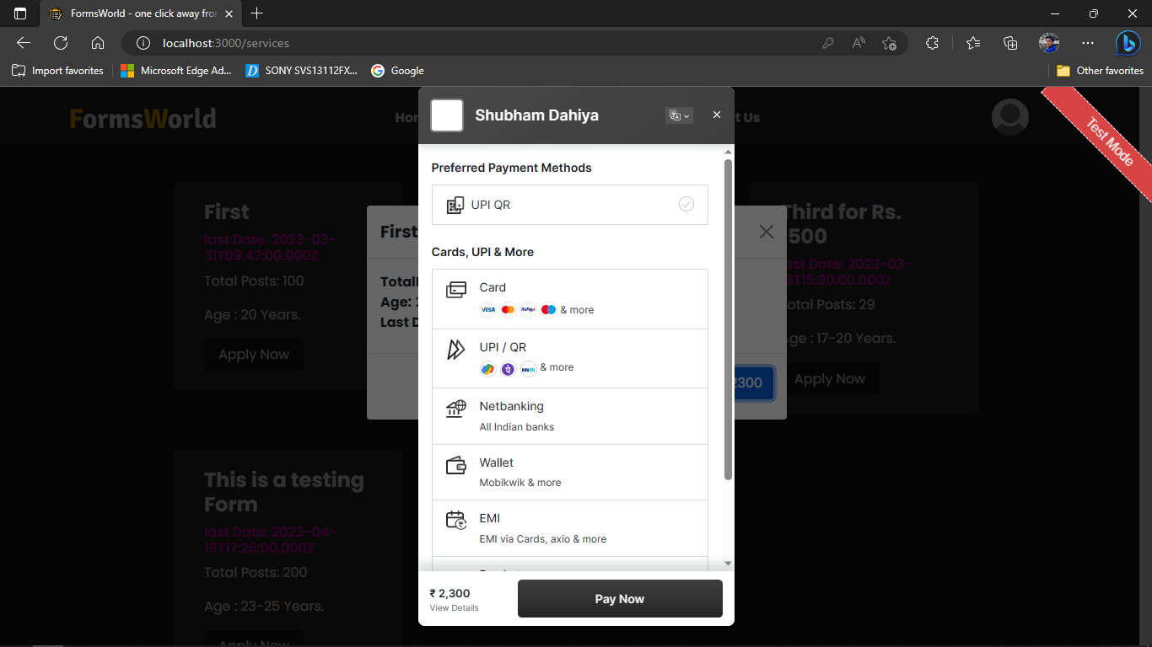
Screen Design
4. Payment Gateway
10

Slide 11
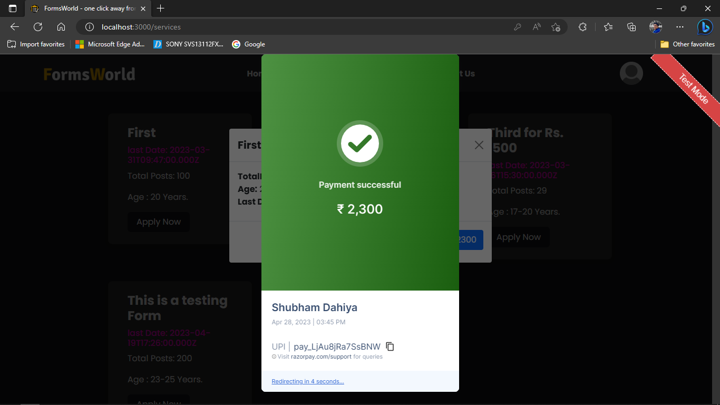
Screen Design
5. Payment Success
11

Slide 12
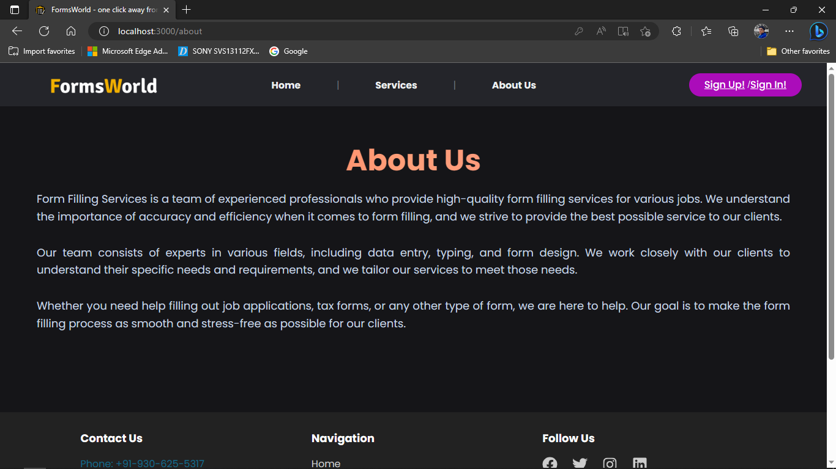
Screen Design
6. About us Page of Forms World
12

Slide 13
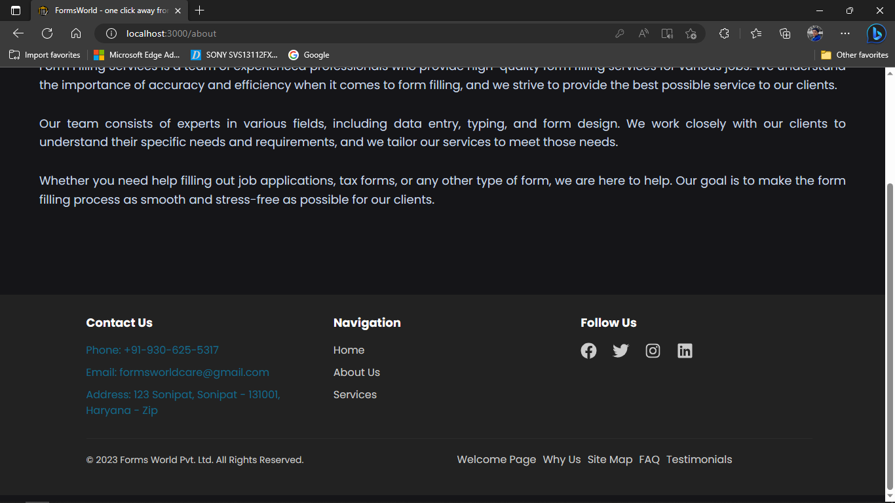
Screen Design
7. About Us Footer
13

Slide 14
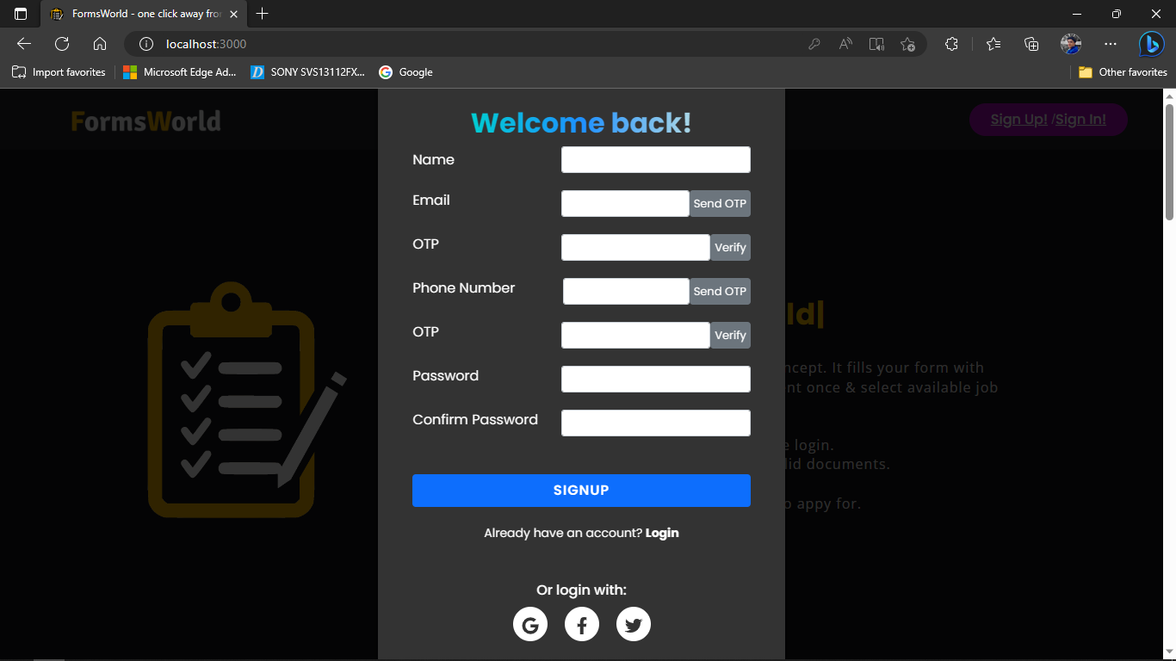
Screen Design
8. Sign up Popup Modal of Forms World
14

Slide 15
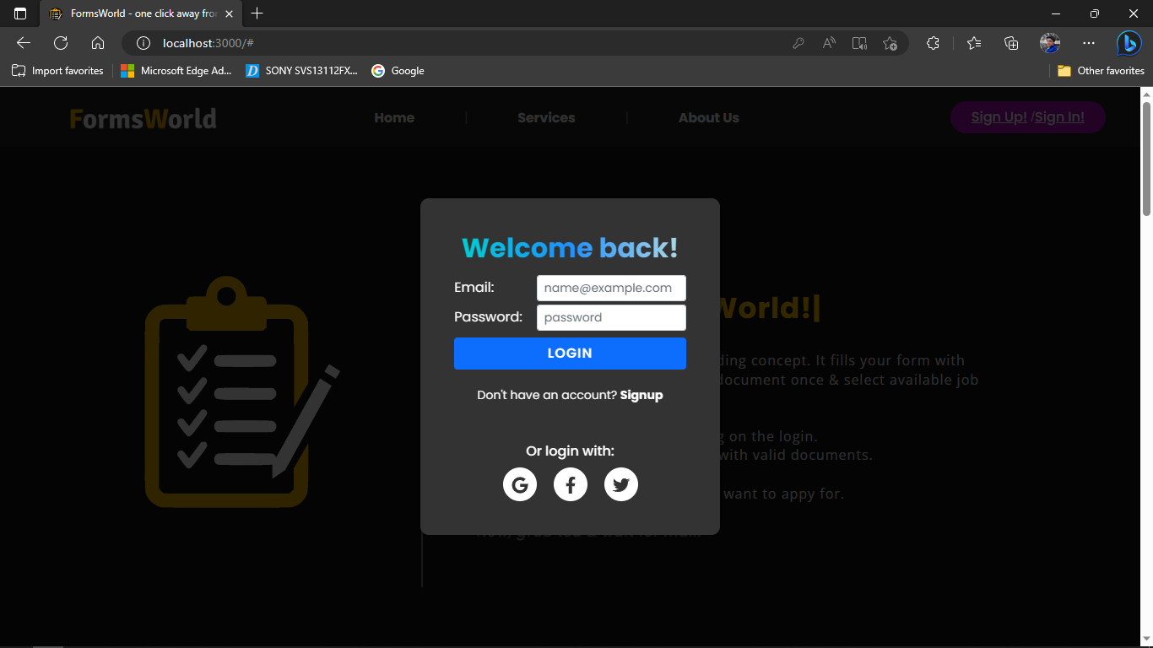
Screen Design
9. Sign in Popup Modal of Forms World
15

Slide 16
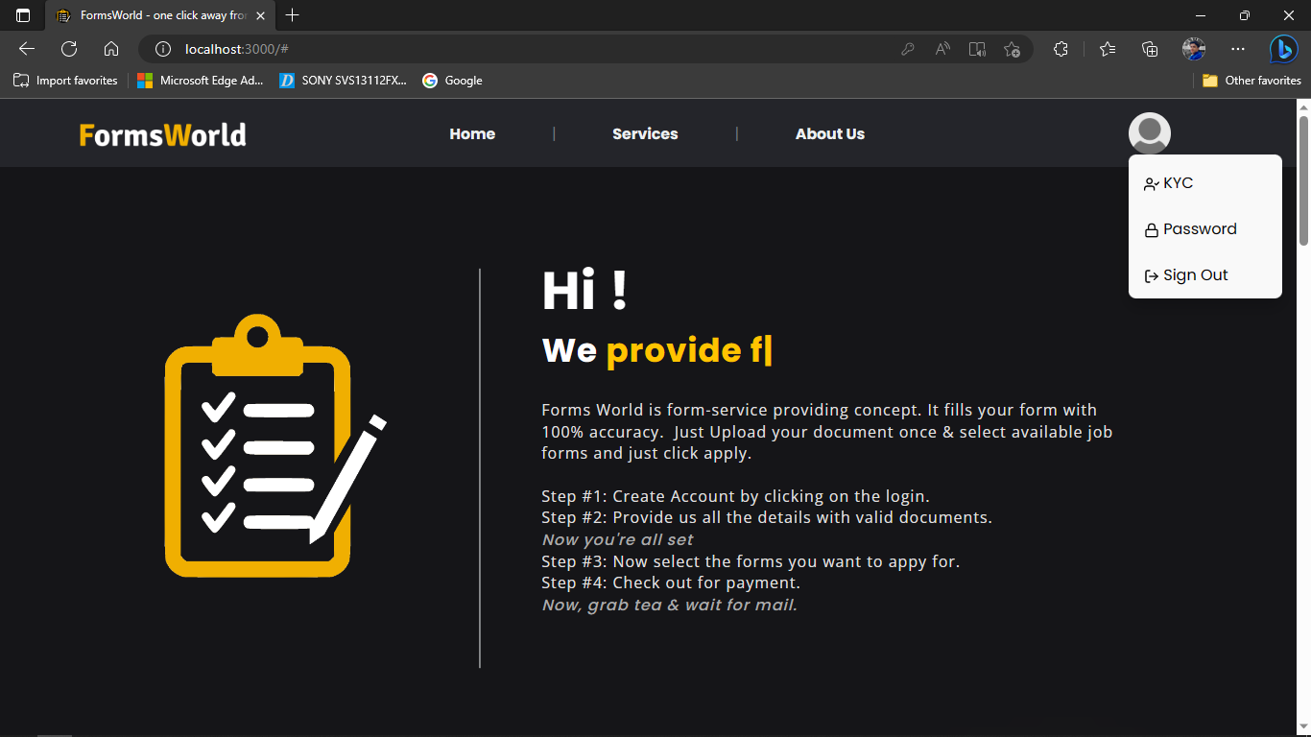
Screen Design
10. Signed in user page options
16

Slide 17
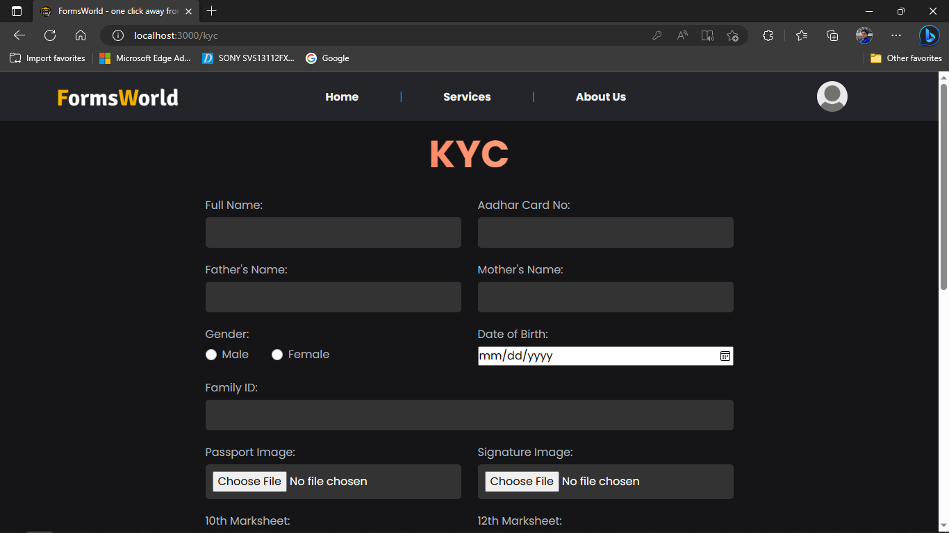
Screen Design
11. KYC page on Forms World
17

Slide 18
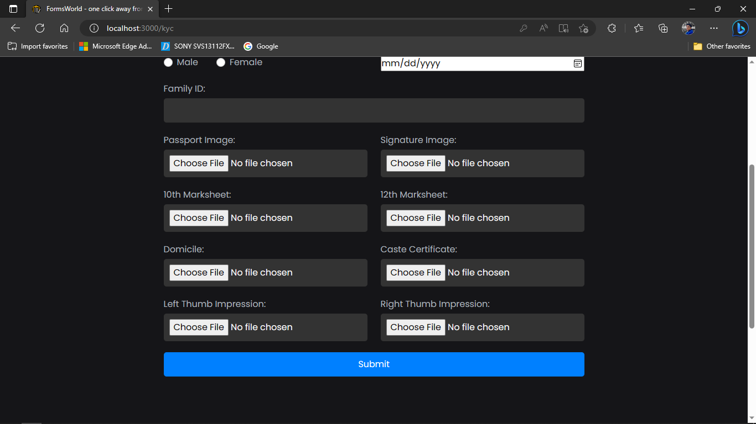
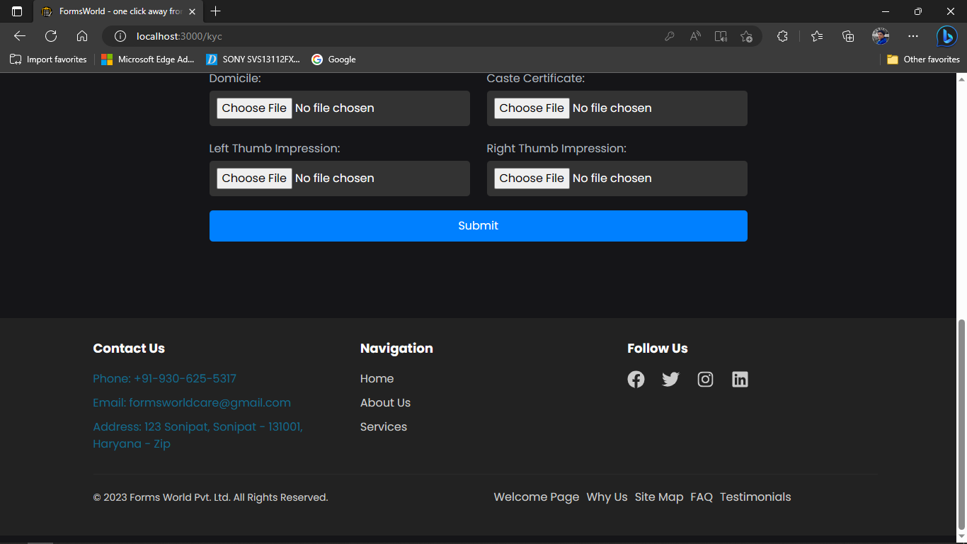
Screen Design
Continued…
18

Slide 19
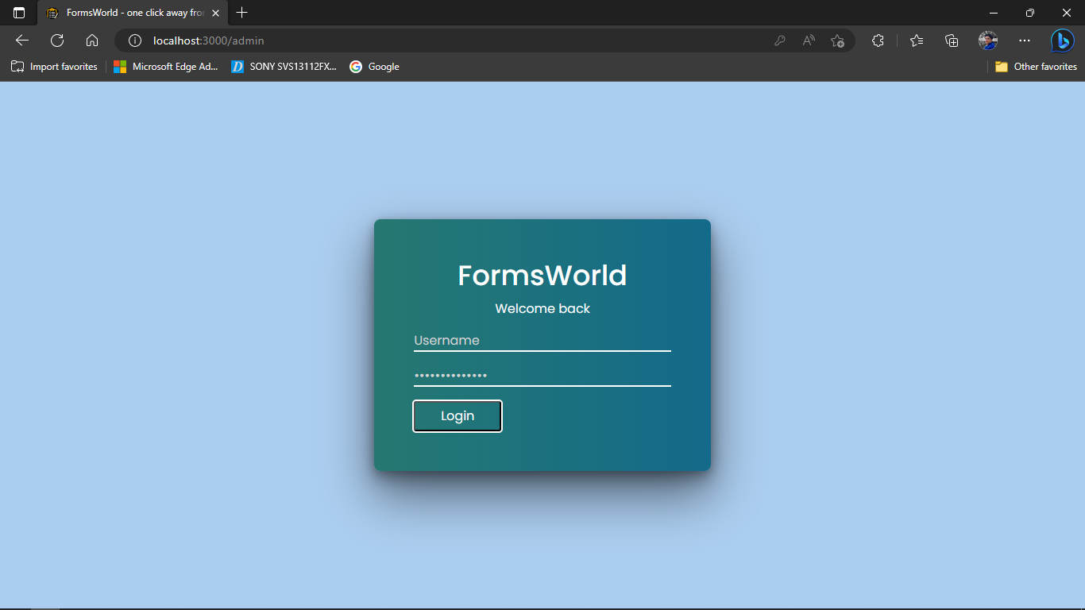
Screen Design
12. Admin page on Forms World
19

Slide 20
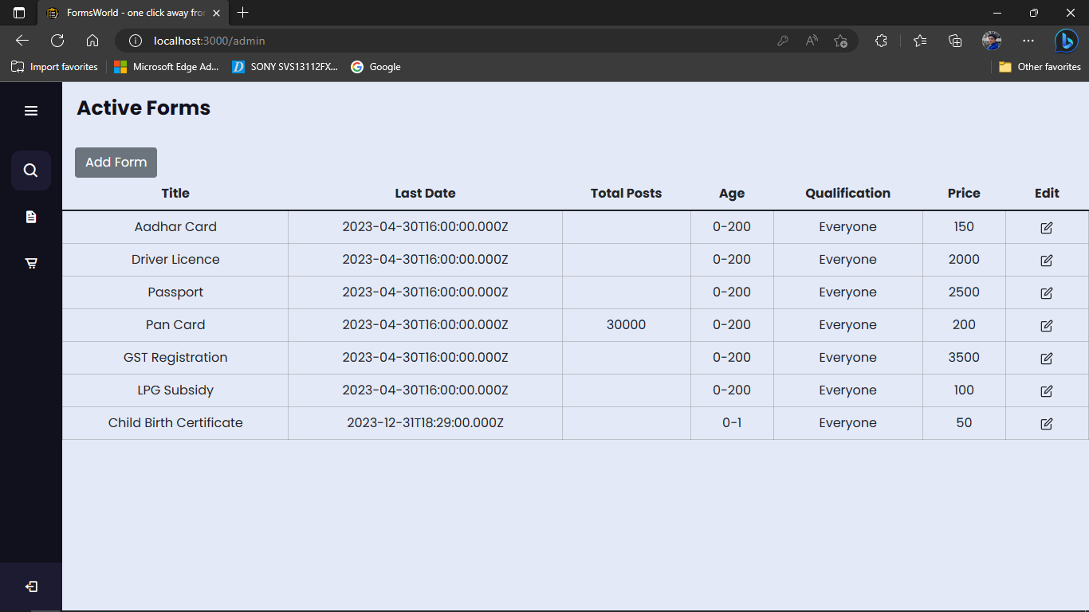
Screen Design
13. Admin logged in showing Active Forms
20

Slide 21
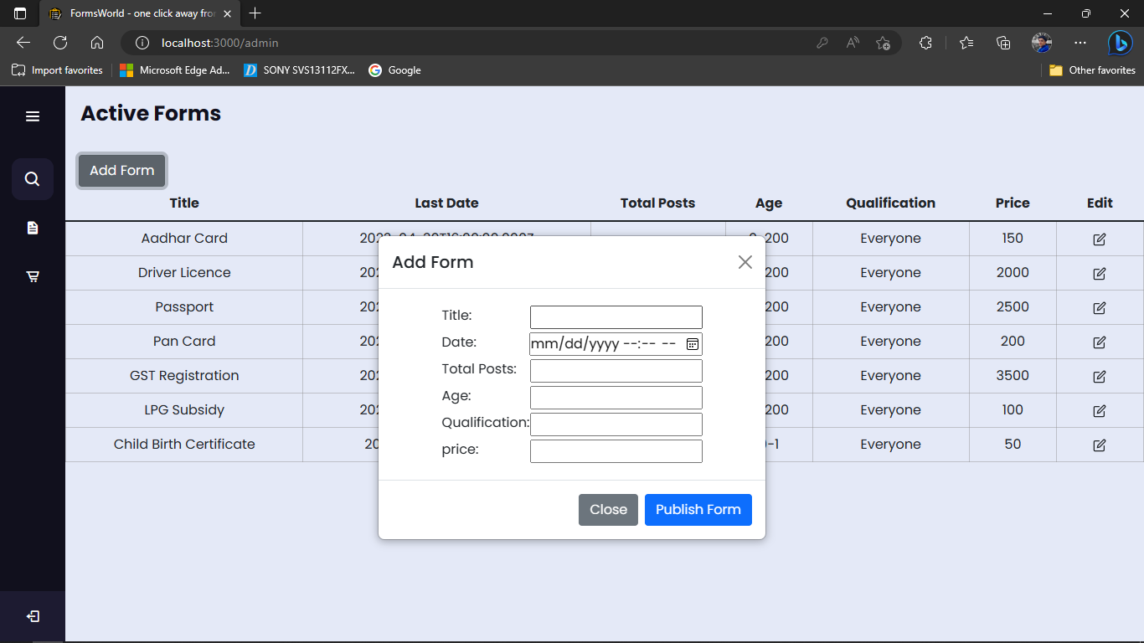
Screen Design
14. Add Form popup Modal
21

Slide 22
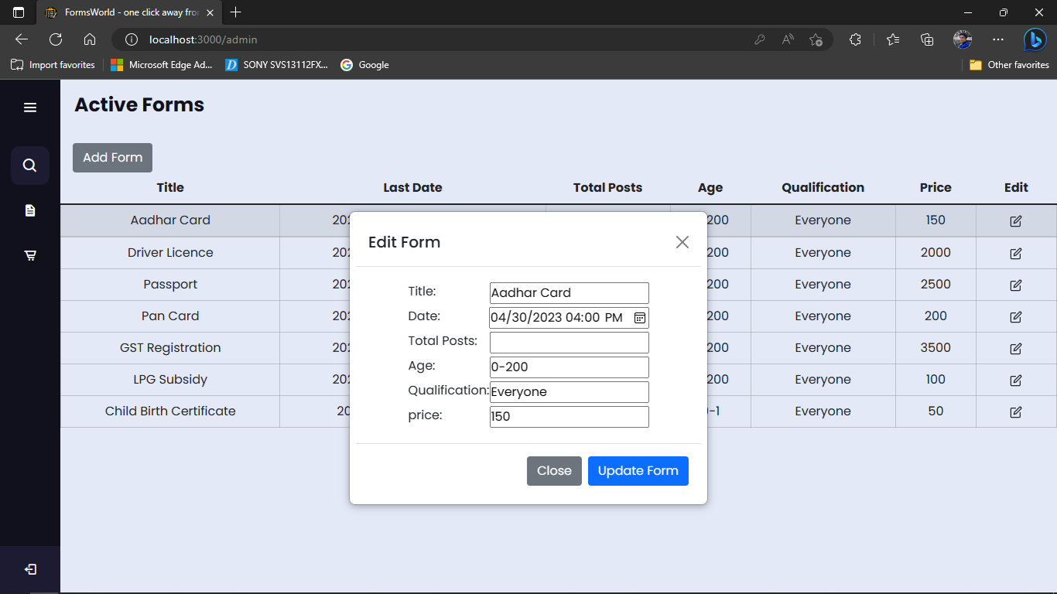
Screen Design
15. Edit Form popup modal
22

Slide 23
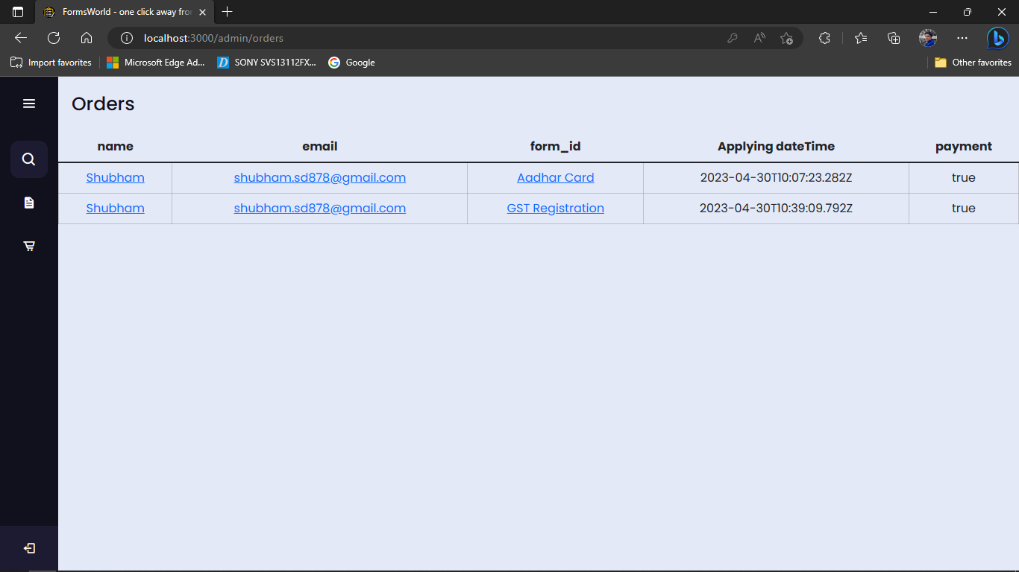
Screen Design
16. Orders Nav on Admin Screen
23

Slide 24
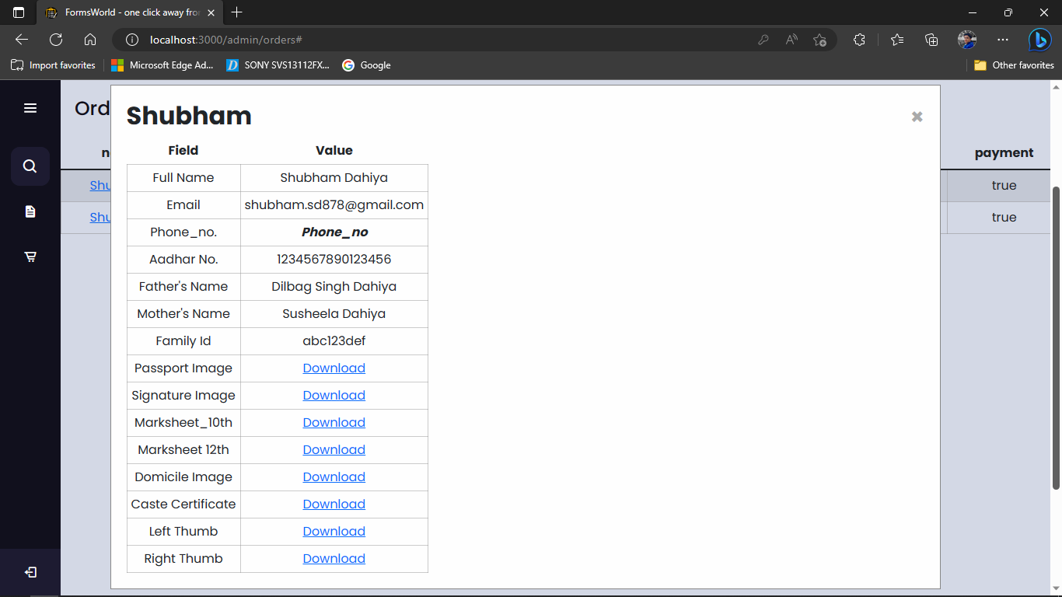
Screen Design
17. User Details modal on Orders nav on Admin page
24

Slide 25
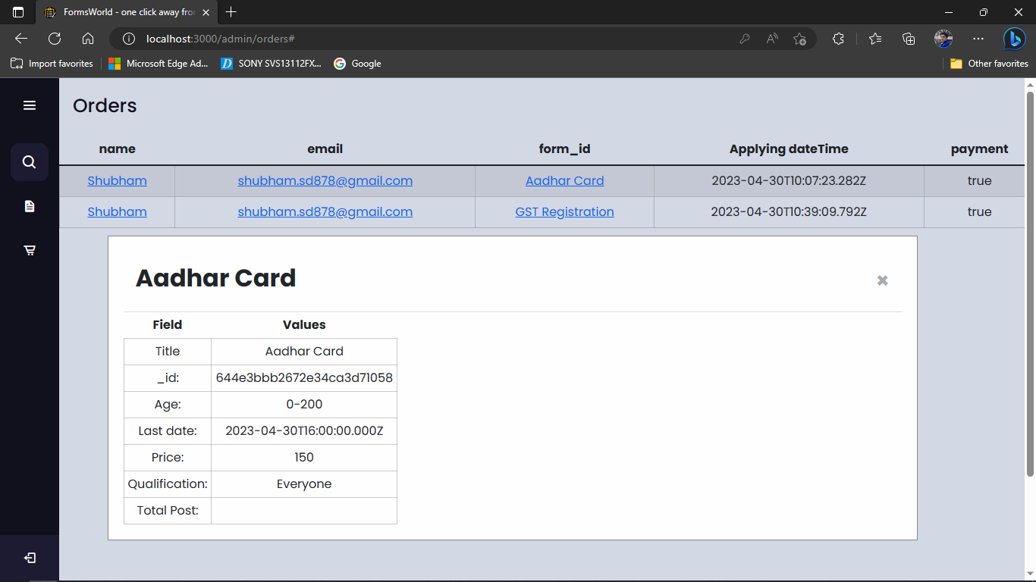
Screen Design
18. Form Details on Orders nav on Admin page.
25

Slide 26
Conclusion
The website offers a user-friendly interface that allows users to easily access and fill out the required forms.
The combination of technologies helped in creating a responsive and interactive website that could handle complex applications.
Forms World includes ensuring data security and implementing reliable payment options.
Overall, the "Forms World" website has been designed to cater to the needs of users seeking form filling services.
26

Slide 27
Future Scope
We will implement status tracking feature on both user and admin side.
We will also add the ability to fetch according to the category of user ( like General, SC, BC, ST) and show them the price according them.
We will improve the user experience.
We will add infinite scroll in services tab.
We will implement infinite scroll in Search bar.
We will add functionality to notifications ability too.
27

Slide 28
Thank You

